Slide 1





By Praba Gladish , Batch code MBE11
Myntra
Analysis

Slide 2


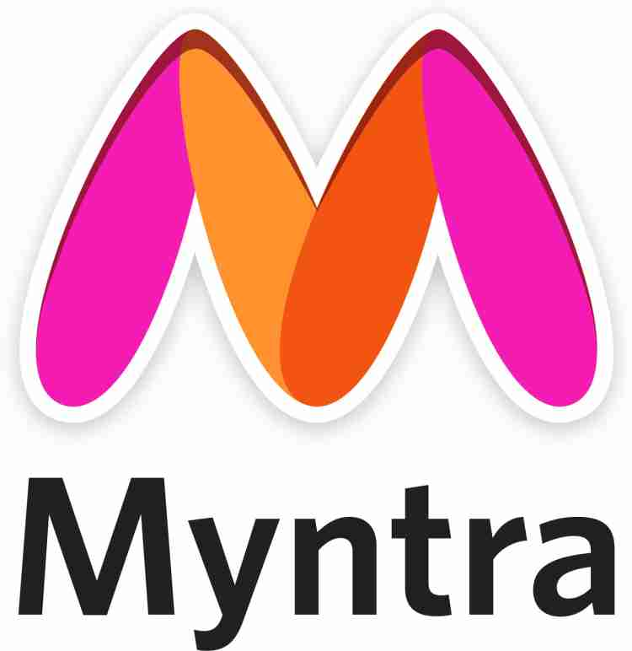
Introduction
Founded: 2007 by Mukesh Bansal, Vineet Saxena, Ashutosh Lawania
Headquarters: Bengaluru, Karnataka, India
CEO: Nandita Sinha
Parent Company: Flipkart (acquired Myntra in 2014 for ₹2,000 crore)
Industry: Fashion and Lifestyle e-commerce
Business Model: Started as a personalized gift items platform and transitioned into a fashion e-commerce company. It now sells fashion and lifestyle products for direct consumers through an online platform (website and mobile app).
Mission: To offer a diverse range of fashion and lifestyle products with a customer-centric approach.
Hi ! This is Myntra

Slide 3



Myntra
Partnerships & Acquisitions
Acquired: Jabong (2016), Native5, Cubeit, InLogg, Witworks
Partnerships: Managing Esprit’s offline stores in India
Collaboration: Ministry of Textiles to promote Indian handlooms.
Market Position & Growth
Market Focus: Fashion-conscious Indian consumers
Growth Drivers: Exclusive products, personalized shopping, mobile-driven innovations
Competitors: Amazon Fashion, Ajio, Meesho, Nykaa
Technological Edge: AI-driven recommendations, express delivery, app-based shopping.

Slide 4


Business Model
Platform: B2C e-commerce platform (Website & Mobile App)
Product Range: Over 150,000 products, 3,000+ brands
Private Labels: Roadster, DressBerry, HRX, House of Pataudi
Services: M-Express (24-48 hour delivery for select items)
Mobile-first Strategy: 95% traffic from mobile, app-centric operations
Revenue Model: Product sales, private label margins, commissions, promotions, express delivery charges.

Slide 5

Myntra Revenue Model Overview (2022-2023 and 2023-2024):
Total Operating Revenue:
FY23: ₹4,375 crore (25% YoY growth).
FY24: Growth expected due to sales events like the Big Fashion Festival.
Product Sales Contribution:
Largest share of operating revenue from fashion, beauty, and lifestyle.
Product Advertising:
FY23: ₹1,758 crore spent (40% of revenue, 36% YoY increase).
FY24: Likely high due to Big Fashion Festival.
Revenue from Payment Options:
Nine-fold growth in credit card payments.
Myntra-Kotak credit card: Eight-fold rise in transactions during key sales.
Overall Revenue Growth:
Strong performance in non-metro areas and strategic partnerships boosting growth.

Slide 6
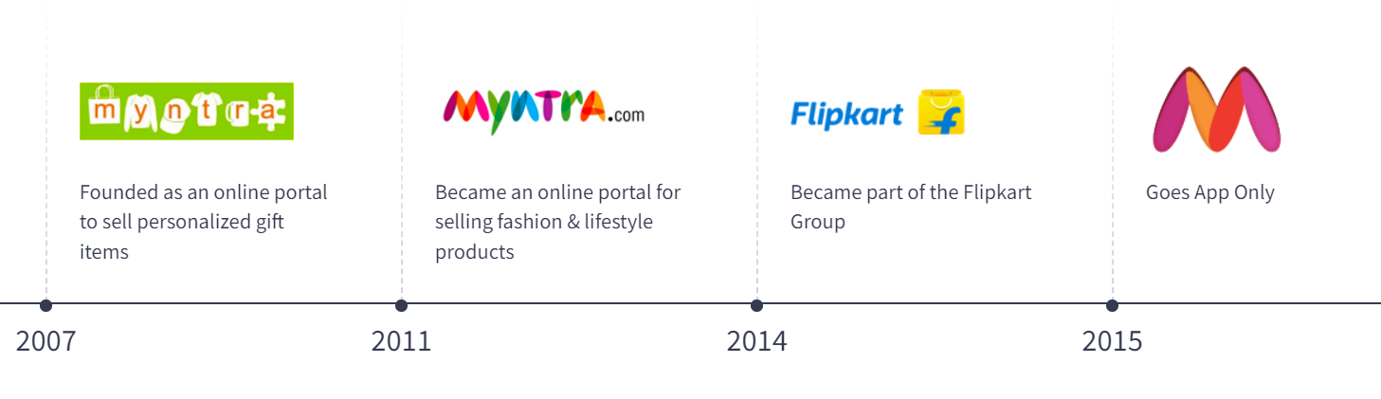
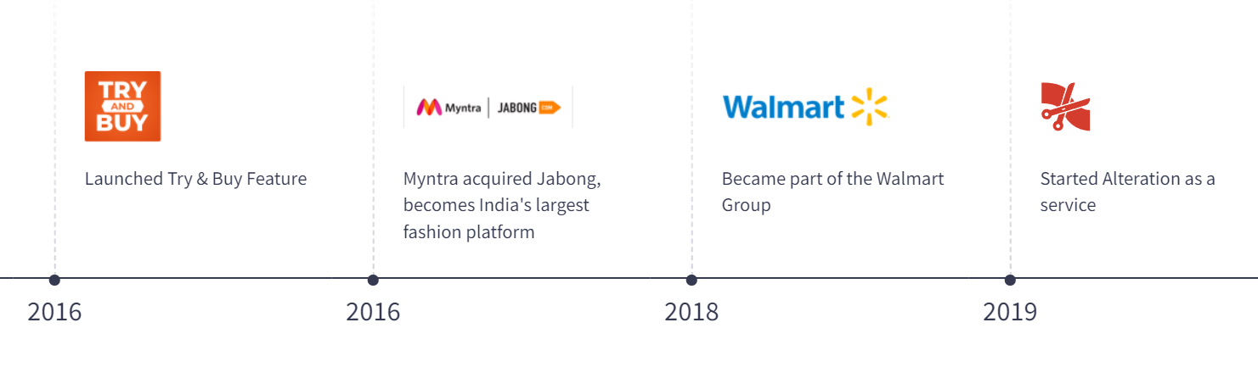

Myntra's Growth Highlights: Pivoted from custom gifts to fashion. Flipkart acquisition boosted growth. Strong private labels (Roadster, HRX). AI-driven personalized shopping. Success with Big Fashion Festival. Expanded into beauty, lifestyle, and non-metro markets. Focus on sustainability with eco-friendly collections.
Myntra's Growth Timeline

Slide 7
Membership Plan - Myntra Insiders
Membership Plan - Myntra Insiders
Free Membership: Accessible to all customers.
Exclusive Discounts: Special offers during major sales.
Early Access to Sales: Members shop before the public.
Reward Points System: Points earned for future discounts.
Personalized Recommendations: Tailored shopping experience.
Engagement Events: Exclusive contests for members.
Membership benefits, including exclusive discounts and early sale access, likely enhance customer retention and encourage more frequent purchases, thereby indirectly boosting overall revenue.

Slide 8
Myntra Total Revenue INR45,092 MN

Slide 9

How Myntra Makes Money
Revenue Generation: Myntra generated approximately US$3.9 billion in revenue in 2023.
Competitive Landscape: Its main competitor, Reliance's Ajio, had cumulative sales exceeding US$2 billion.
Diverse Income Sources: Myntra’s income streams include:
E-commerce Sales: Revenue from the sale of fashion, beauty, and lifestyle products.
Logistics Services: Earnings from logistics and delivery services.
Advertising Revenue: Income from brands advertising on the platform.
Partnerships: Collaborations with various brands and retailers enhance revenue streams.
Logistics:
Established partnerships for efficient logistics operations.
Imposes delivery fees on orders, with customers covering most costs.
Generated INR 19,915 million from logistics services in 2023.
Marketplace Services:
One of India’s largest fashion marketplaces, offering a wide range of products.
Charges commissions from sellers and customers based on order size and product type.
- Generated INR 17,812 million in gross revenue from marketplace services in 2023.
Advertisement:
- Myntra is a popular platform for brand promotion and advertising.
- Brands pay fees to showcase their products on Myntra’s website and app.
- Generated INR 5,353 million in revenue through advertising in 2023.
These revenue streams contribute significantly to Myntra's overall profitability.

Slide 10

Myntra SWOT Analysis
Strengths:
Vast Product Inventory: Offers over 5,000 brands.
Extensive Supply Network: Reaches 90,000+ locations nationwide.
User-Friendly Technology : Reliable technology and interfaces enhance customer experience.
Innovative Features: Includes visual search and virtual trial rooms powered by augmented reality.
Affordability and Quality: Known for providing affordable products without compromising on quality.
Weaknesses:
Intense Competition: Faces strong competition from brands like Amazon, Ajio, and Meesho impacting profits and market share.
Customer Experience Issues
Fake MRP (Maximum Retail Price) listings.
Lack of customer support (no response to phone calls).
Delayed deliveries and pickups.
Issues with refunds and automatic order cancellations.
Misleading discounts and fake tags.
Wrong products delivered.

Slide 11
SWOT Analysis
Opportunities:
Private Label Sales: Potential financial growth from increased private label sales.
Bridal Market: Expanding offerings in the lucrative bridal market in India.
Utilizing Flipkart's Network: Leveraging the parent company Flipkart's network for greater exposure and sales.
Threats:
Formidable Competition: Challenges in expanding the consumer base due to Amazon's strong reputation and large customer base.

Slide 12
Myntra Financials

Slide 13
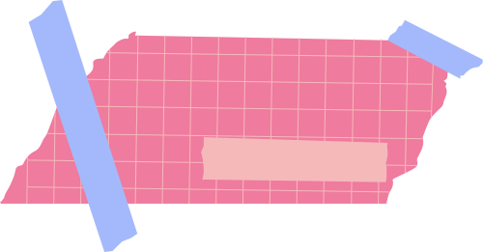
Myntra - Growth and Revenue
It has 60 million average users as of March 2024
The company has over 6,000 brands as of March 2024
It has delivered to over 19,000 pin codes across India as of March 2024
It has 75 million new app users as of December 2023
Myntra offers products from more than 6,000 brands as of December 2022

Slide 14
Customer Review Analysis of Myntra
Methodology
Platforms Analyzed: Twitter, Instagram, Facebook, and product reviews.
Review Categorization:
High Impact: Reviews that strongly influence buying decisions.
Medium Impact: Reviews that moderately affect customer perceptions.
Low Impact: Reviews that have minimal influence on purchasing behavior.
Findings
High Impact Reviews:
Positive feedback focused on product quality and variety.
Praised the platform for its extensive collection and affordable pricing.
Medium Impact Reviews:
Highlighted usability of the platform and features like visual search and virtual trial rooms.
Low Impact Reviews:
Complaints mainly about delivery delays, customer service issues, and lack of response.
Problems with automatic cancellations, pickup delays, and fake discounts also noted.

Slide 15
Consumer Reviews
Medium Impact Consumer Comments:
Payment Process Frustrations
Good Product selection, but the app is slow and has delays adding items to the cart.
App lags when scrolling; decent customer service, but unclear return rejections.
Great fashion options, but delivery delays, especially during festive seasons.
Mixed experiences, product images sometimes inaccurate, and stock issues at checkout.
Generally good product quality, but the app frequently freezes or crashes.
Order tracking can be unreliable; Great products but needs better delivery and app performance.
High Impact Reviews:
Affordability and Discounts – A major draw for
budget-conscious buyers.
Product Quality – Particularly for its private labels and premium brand collections.
Wide Variety – Keeping pace with the latest trends and offering diverse styles.
Technology Integration – Personalized suggestions enhancing user experience.

Slide 16
Low Impact Consumer Comments:
MRP: Inflated maximum retail prices lead to distrust in discounts.
No Customer Support: Difficulty reaching customer support via calls or emails.
Delay in Delivery: Frequent delays, especially during sales.
No Refunds: Issues with not receiving refunds for returned items.
Automatic Cancellation: Orders canceled automatically after purchase during sales.
No Response to Queries: Lack of response from customer support to emails and calls.
Fake Discounts: Discounts are perceived as not genuine or misleading.
Wrong Products: Items received do not match what was ordered.
Price Fluctuation: Prices change frequently within a single day.
Discount Announcement: Customers want clear communication about discount periods.
Cart Price Changes: Prices unexpectedly change when items are added to the cart.
Complicated Discount Application: Many criteria for applying discounts lead to confusion.
Need for Proper Price Tagging: Customers seek transparent and consistent pricing information.

Slide 17
Competitive Analysis
Company | Focus | Key Strategy | Strenghts
Myntra | Fashion & lifestyle e-commerce | - Strong private labels (e.g., Roadster). - Exclusive brand partnerships (H&M, Nike). - AI-driven personalization. | - Deep presence in the fashion sector. - Effective influencer marketing and large sales events.
Ajiio | Fashion & lifestyle, part of Reliance Retail | Omnichannel retailing with online and offline stores. - Aggressive discounts. - Focus on both local and global brands. | Backed by Reliance's strong supply chain and pricing power. - Integration of mobile-first strategies.
Meesho | Social commerce for small retailers | Reseller model via social platforms like WhatsApp/Facebook. - Low-cost, unbranded fashion. - Focus on tier 2/3 cities. | Empowers individual resellers. - Expanding rapidly in non-urban markets with low overhead costs.
Nykaa | Beauty, wellness, and fashion | Offers premium and mid-range products. - Content-driven marketing (blogs, tutorials). - Strong private labels. | Strong in the beauty category. - Trusted for premium beauty products with an omnichannel presence.
Amazon India | General e-commerce, including fashion | - Broad marketplace model with third-party sellers. - Amazon Prime driving loyalty. - Focus on fast delivery with AI-driven recommendations. | Excellent logistics network. - Comprehensive product offering across categories
Flipkart | General e-commerce, large focus on fashion and electronics | Big Billion Days for aggressive sales. - Focus on private labels (e.g., MarQ). - Developing video commerce for engagement. | Strong penetration in tier 2/3 cities. - Loyalty program (Flipkart Plus) similar to Amazon Prime

Slide 18

Strategic Recommendation
Ensure Pricing Transparency:
- Regular audits on product listings to verify MRP accuracy.
- Display clear price breakdowns showing original price, discounts, and final prices.
Enhance Customer Support Availability:
- Introduce AI-driven chatbots for 24/7 instant support.
- Increase availability of human support through live chat and phone.
Optimize Logistics and Transparency:
- Strengthen partnerships with reliable delivery services.
- Offer real-time delivery tracking and alerts for potential delays.
Simplify and Speed Up Refund Processes:
- Implement automated refund systems with specific timeframes.
- Offer instant store credit refunds to speed up the process.

Slide 19

Strategic Recommendation
Increase Trust in Discounts:
- Regularly audit and verify promotional offers.
- Display clear terms of discounts and product price history.
Improve Product Authenticity Verification:
- Ensure all products are delivered with proper tags and branding.
- Conduct stricter quality checks for authenticity of branded items.
Improve Order Accuracy:
- Use barcode scanning technology to verify correct products before dispatch.

Slide 20

Strategic Recommendation
Lock Cart Prices:
- Lock prices for items in cart for a set duration to avoid unexpected changes.
Simplify Discount Application:
- Automatically apply applicable discounts at checkout.
Seek Help from Social Media Influencers:
- Collaborate with influencers for honest reviews and promotions.
- Use influencers to wear and review products, building trust and driving revenue growth.

Slide 21
Strategic Recommendation
Stabilize Pricing:
- Implement price stability periods to avoid frequent fluctuations.
- Notify customers of upcoming price changes in advance.
Improve Inventory and Order Management:
- Use real-time inventory tracking to prevent automatic cancellations.
- Notify customers early if items are unavailable and offer alternatives.

Slide 22
Strategic Recommendation
Explore Offline Channels:
- Increase offline presence by opening physical stores or pop-up shops.
Enhance Customer Support:
- Implement AI chatbots for quick resolutions.
- Train customer service teams to handle complex queries efficiently.
Improve Sizing Experience:
- Provide detailed size charts specific to brands.
- Implement virtual try-on tools to help customers select accurate sizes.
- Offer flexible exchange policies for size-related issues.
Strict Quality Control for Inconsistent Product Quality:
- Enforce strict quality control, especially for third-party sellers.
- Award "Authenticity Badges" for products that meet specific standards.
- Implement a customer feedback loop to remove low-quality products receiving repeated complaints.
Focus on Delivery Times:
- Partner with reliable delivery services and explore local delivery tie-ups.
- Provide real-time tracking and accurate delivery timelines.
- Offer discount vouchers to customers in case of delivery delays.
Provide Exceptional Post-Sale Services:
- Enhance customer support availability with 24/7 service via multiple channels.
- Offer easy returns, refunds, and fast customer support for post-sale issues.
Expand Private Label Offerings:
- Invest in expanding Myntra’s private label brands to boost exclusivity and margins.
Leverage AI and Machine Learning:
- Implement AI tools for customer support, personalization, and virtual try-ons.
- Use ML for personalized product recommendations based on customer behavior.

Slide 23
Strategic Recommendation
Introduce "Quality Verified" Badges:
- Assign badges for products with consistently positive reviews for quality.
Improve Product Presentation:
- Use consistent lighting and avoid heavily edited product images.
- Provide 360-degree views and short video clips to showcase products more realistically.
Regular App Updates to Fix Glitches:
- Release regular updates to fix bugs and enhance navigation.
- Improve UX based on user feedback to ensure smooth app performance.
Enhance Filtering and Sorting Options:
- Add advanced filtering and sorting options (e.g., material, sustainability, trending collections).

Slide 24
Website used for Analysis
https://snackfax.com/
https://www.indiaretailing.com/?s=myntra
https://en.wikipedia.org/wiki/Myntra
https://www.youtube.com/watch?v=C8L51liFIFk
https://www.instagram.com/myntra/reels/
https://startuptalky.com/myntra-business-model/
https://www.similarweb.com/website/myntra.com/#demographics
https://chatgpt.com

Slide 25

CONCLUSIONS
This project gives clear idea to develop critical insights into Myntra’s reputation, identify trends, and craft solutions that are driven by consumer feedback. It also emphasizes the importance of data-driven decision-making, customer-centric strategies, and operational excellence in achieving sustainable growth without the need for advanced technical tools.

Slide 26
THANK
YOU!

